Slide 1
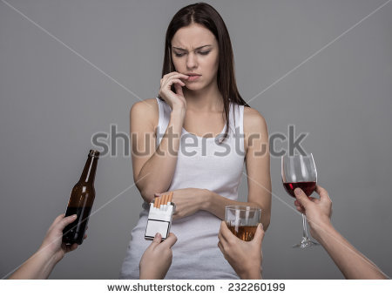
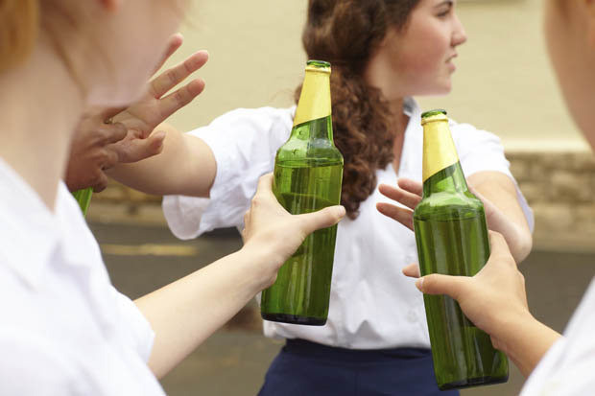
Health and Family Life Education
Empowering Young Minds Through Life Skills Education

Slide 3
Health and Family Life Education Begins
In 1994, the CARICOM Standing Committee of Ministers of Education passed a resolution to support the development of a comprehensive approach to HFLE by CARICOM and the University of the West Indies (UWI). Support was also solicited from the United Nations agencies and other partner agencies working in the Region. In 1996, Ministers of Education and Health endorsed the document, "A Strategy for Strengthening Health and Family Life Education (HFLE) in CARICOM Member States."

Slide 4
At the Sixth Special Meeting of the Council for Human and Social Development (COHSOD) held in Trinidad and Tobago in April 2003, the Council, realizing the significant contribution that HFLE can make to help young people develop skills to build competencies and adopt positive behaviours, endorsed the need to develop a Life-Skills based HFLE Regional Curriculum Framework. This Framework, with Regional Standards and Core Outcomes, shifted the focus from what was a knowledge-based curriculum to one that was life skills-based.

Slide 5
The Framework was intended to serve as a guide to member states to review or develop their national life skills HFLE curriculum. Additionally, the COHSOD agreed that HFLE should be a core area of instruction at all levels of the education, and should also be used to develop out-of-school youth programmes.

Slide 6
Why Health and Family Life Education?
There is the perception that traditional curricula do not ensure that children and youth achieve their full potential as citizens. In addition, increasing social pressures are impacting on young persons in ways that make teaching a challenge. Teachers are finding that young people are more disruptive, are more likely to question authority, and see little relevance of schooling that fails to adequately prepare them for their various life roles.

Slide 7
The paradox is that schools are now seen as key agencies to redress some of these very issues. HFLE, then, is a curriculum initiative that not only reinforces the connection between health and education, but also uses a holistic approach within a planned and coordinated framework. It “is perceived as the viable way to bridge existing gaps to enable young persons to attain the high levels of educational achievement and productivity required for the 21st century.” (UNICEF/CARICOM, 1999.)

Slide 8
What is Health and Family Life Education?
HFLE is a comprehensive life skills based programme which focuses on the development of the whole resilient person.
It helps young people understand that the choices they make in everyday life profoundly influence their health and personal development into adulthood.

Slide 9
The Themes of H.F.L.E
The four thematic areas of H.F.L.E are as follows:
Sexuality and Sexual Health
Self and Interpersonal Relationships
Eating and Fitness
Managing the Environment

Slide 10
What are Life Skills?
The World Health Organization (WHO) defines life skills as “abilities that enable one to adopt positive behaviours’.

Slide 11
Categories of Life Skills
There are three categories of life skills. These are :
COGNITIVE SKILLS
SOCIAL SKILLS
EMOTIONAL/COPING SKILLS

Slide 12
Types of Life Skills
Decision making
Problem solving
Creative thinking 
Critical thinking 
Effective communication
Interpersonal relationship skills
Self awareness

Slide 13
Types of Life Skills (contd)
Empathy
Coping with emotions
Coping with stress
Negotiation skills
Refusal skills
Assertiveness skills
Healthy self management and monitoring skills

Slide 14
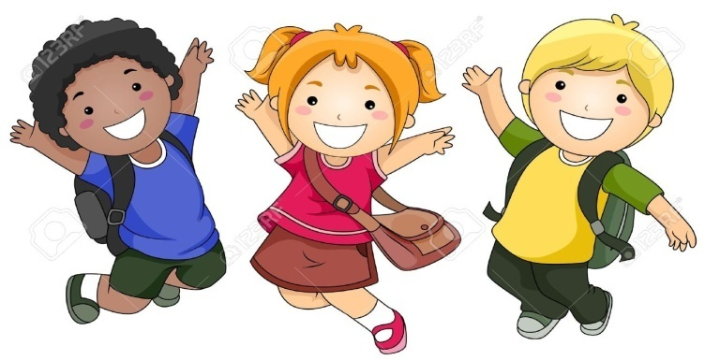
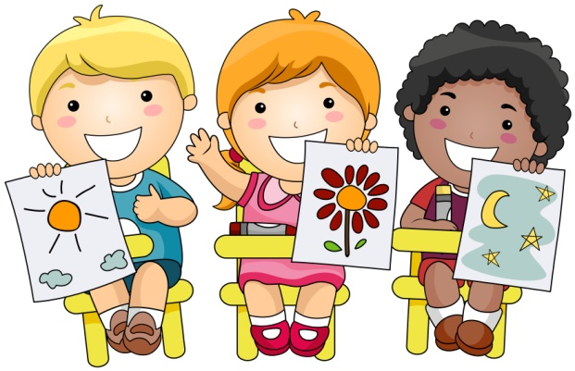
Enjoy empowering young minds through life skills education !

